Slide 1

2024 Rancho Murieta
Integrated Water Master Plan (Draft)
Analysis & Response

Slide 2


Rancho Murieta Water
….................whisky is for drinking,
Water is for fighting over.
Mark Twain

Slide 3
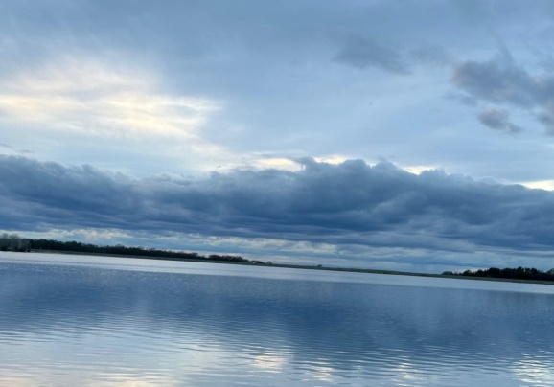
Purpose of the Analysis
To determine if the data, determinations, suggestions and options presented in the Integrated Water Master Plan (IWMP) Draft are supported by current information, requirements, and statistics.
To determine the Supply & Demand of water available for the existing community and current homes in process of being built.
To determine if proposed (but not yet County approved) development of 945 residential lots can be supported by our existing, available water supply.
To determine the feasibility of the 4 Options proposed by the 2024 IWMP Draft

Slide 4
The Development Process
Application to County for entitlements (i.e., change Zoning from Agriculture to Residential)
Technical studies by Developer required (traffic, artifacts, etc.) $$$
Water, sewer and drainage studies prepared by Developer
CSD reviews water, sewer, and drainage studies and comments to Sac County
Application complete. County requires CSD to submit a Water Supply Assessment (WSA)
CSD has 90/120 days to reply: water yes water no partial water

Slide 5

The Water Supply Assessment (WSA) is based on the Integrated Water Master Plan (IWMP)
What is the IWMP and why it is so important?

Slide 6
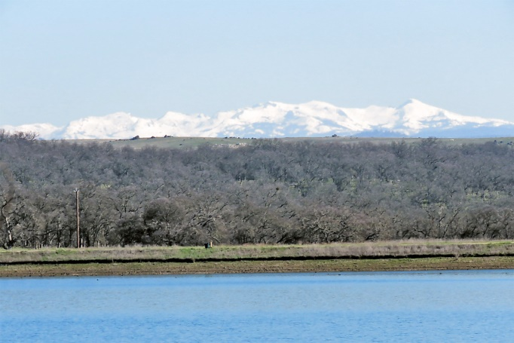
Future Development *
The long process of approval or disapproval begins here:
Community Planning Advisory Council (CPAC) review and recommendation to County Planning Dept. (Public Meeting)
Environmental Impact Review (EIR) Scoping Meeting (Public Meeting)
EIR preparation (no less than a year…sometimes two years or more)
Comment period on EIR (public comments solicited)
Planning Commission review and recommendation to Board of Supervisors
Board of Supervisors vote to approve, disapprove or send back for change
*Murieta Properties 39 acres adjacent to CSD Bldg. is approved for 160 apts. & 88 houses + a pending application for 697 more lots around the lakes for a total of 945 residences that remain incomplete since 2014

Slide 7
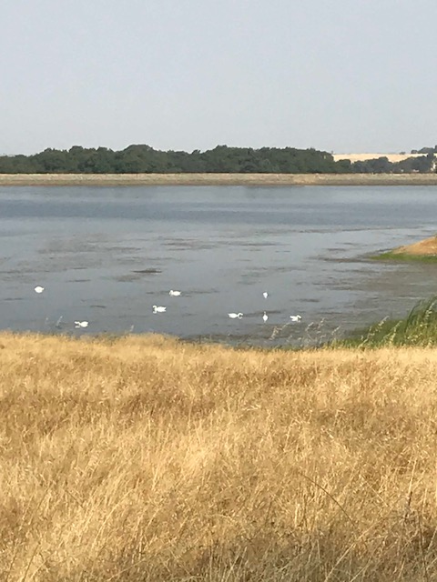
Issues surrounding the Developers
request for Entitlements (Water Permits)
The District Permit allows us a maximum of 6,000 acre feet of water per year from the River subject to pumping restrictions.
The District has an insufficient amount of reservoir storage.
The district has no authorization to build a new reservoir or to deepen an existing reservoir. This process could cost tens of millions.
Historical measurement of storage capacity has been overstated.
Bathymetrics (study of underwater topography) and dead storage estimates revise current storage capacities.
The District has restrictions on quantities of water it can store and where it can store them.

Slide 8

The District has no
EmergencyWater Supply.
SB 552 REQUIREMENTS: “No later than January 1, 2027, have at least one backup source of water supply, or a water system inter-tie, that meets current water quality requirements and is sufficient to meet average daily demand.”
However, the Integrated Water Master Plan (IWMP) does not recommend a quantity of water that will be considered an adequate emergency supply.

Slide 9
Existing Storage and Resulting
Emergency Water Supply
STORAGE IN PERMITTED CALERO AND CHESBRO RESERVOIRS | ACRE FEET
Gross Storage Combined Calero + Chesbro including stop logs, using bathymetric results of reservoir capacity* | 4,010
Evaporation Calero + Chesbro @20% | (802)
Seepage Calero + Chesbro | (280)*
Dead Storage Calero + Chesbro | (315)
Net Storage Combined Calero + Chesbro (assumes 100% full on June 1 of a water year after subtracting annual losses for evaporation, seepage and dead storage | 2613
Actual Water Demand on 12/31/2022 (includes water billed and systems losses and un-billed water | 1,716
Entitled Development Beyond 12/31/2022
+ Retreats | 24
+ Riverview | 92
+ Residences | 165
+ Murieta Gardens | 0.6
Total Present Water Demand + All Future Entitled Demand for which there are county approved maps | 1997.6
May to November Demand (68% of Production | 1,357
Excess Storage In Calero and Chesbro at the end of diversion on June 1 (assumes 100% full) | 1,256
Supply on November 1 of a water year without conservation in place. | 740

Slide 10

Integrated Water Master Plan(IWMP)
The Integrated Water Master Plan (IWMP) Draft “suggests” four (4) mitigation strategies (options) available to CSD that might offset the shortage of water storage and may mitigate the lack of emergency storage. They are:
Options
A. Drill groundwater Wells to augment the water supply.
B. Use raw water on golf courses and recycled water on houses.
C. Implement a drought plan which will yield more water (i.e., Conservation)
D. Use of Lake Clementia as a potable water source

Slide 11
Groundwater and Wells
Conclusions
RMCSD has attempted 5 times to find well sites that would produce 1200 GPD each to generate enough water for the existing community. 2000 GPD needed for the full build out.
Our aquaphor and basin are small and may not have the geology to produce the necessary water.
Noted resident geologist, Greg Wheeler, PhD. in Geology and Professor at Sacramento State from 1978-2018 has submitted a letter outlining the problems with our aquaphor saying the Ione and Gopher formations are unsuitable for the needed water production.
Other problems involve drilling near the river and getting Well Permits (5 years), and the massive costs.
2024 IWMP (draft) relegates Wells to an emergency use only consideration.
Groundwater Wells have been proposed in quantity by the 2024 IWMP as a possible solution to Rancho Murieta’s emergency water needs and for development build out.
A Closer Look- Its not the first time that RM has considered ground water wells as an option for our water shortage. Studies and examination numerous times over the past 35 yrs.
There needs to be a ground water supply to have a well. Ground Water is the water that is stored underground in layers called Aquifers and Basins, Some feasible as a water source, some not.
Historical info back in 1970 by an engineering firm claimed “groundwater in this area is of such poor quality and low quantity, that wells are not recommended as a source of raw water.”
Further studies in 1988 Ludhorff & Scalmanini; 1994 &1995 Eaton Drilling 6 test holes; 2002 Geoconsultants; 2003 HDR;, and the Dunn report in 2013, a very technical report with two test holes drilled. Acceptable well productivity was questionable.

Slide 12
Groundwater Wells
IWMP page 31........
Finally the 2024 IWMP came to the following conclusion,
……“However, as regional ground water availability declines, it is important to consider the potential uses of new wells: long-term daily flow augmentation is likely unsustainable for the District.
Thus, a well should be considered an emergency source or drought resilience and not to be used to augment normal daily demands.”
If groundwater can be found, it may prove a modest enhancement to the emergency water supply.
There is no evidence that the consultant or engineer has met with the Cosumnes
Groundwater Authority.
Groundwater wells do not contribute to a supply of water needed to support development.
Well costs, with 5 wells with either partial or full treatment:
$10,400,000 - $42,940,000

Slide 13
Recycled Water
With proof of an insufficient supply, the draft IWMP altered the recycled water assumption. It assumes recycled water will be used to irrigate all developer lots and dual piped existing homes, while the RMCC golf courses will be irrigated by raw river water.
The Draft IWMP overstates the future recycled water supply. The study numbers are mathematically impossible to achieve.
The CSD has a 1988 contract with the Rancho Murieta County Club to supply 100% of their recycled water needs, up to and including drought and low water conditions.
River flow charts show there is insufficient river water available to keep the golf courses alive during the summer months.
The existing CSD discharge permit does not allow use of tertiary treated water for residential properties.
There’s no infrastructure in place to deliver recycled water to the developer lots, while piping exists to service the golf courses.
RECYCLED WATER ASSUMPTION
The CSD 2006 and 2010 studies assumed recycled water would be used to irrigate the RMCC golf courses and all developer properties.
CSD’s 1990 Study specifically states that even at full buildout there will be insufficient recycled water to irrigate developer homes in all but heavy rainfall years.
A document authored by John M. Sullivan August 4, CSD Recycle Water Balance 2021, states that the study numbers are inaccurate and there is an insufficient supply for the assumption to work.
As a result of this document and John Sullivan’s claim, the Residences and Riverview projects are not required to install the infrastructure needed to use recycled water.

Slide 14
Additional Info on Recycled Water
A 1970 a feasibility report done by George S. Nolte civil engineering company included no plan for recycled water.
May 17,1988- Agreement for Availability and Use of Reclaimed Wastewater for irrigation purposes. The irrigation areas included North and South golf courses, the future RMA Community Park, and the future HOA Assoc. Corp Yard.
The document also states that the District does not guarantee the quantity of reclaimed wastewater but the District is responsible to deliver raw water(from Clementia) to meet the irrigation needs of the Golf Courses and lands mentioned above.
It appears that in a preliminary report in 2017 some consideration was given to exploring the use of recycled water on residential landscaping. Problems occurred with comingling of surface water and local runoff as well as a lack of available recycled water.
Sullivan’s report in August of 2021 refers to putting in purple pipe for recycled landscapingat the Residences East and West but no permit or infrastructure in place. Now only the Van Vleck Sprayfield is permitted to accept extra Tertiary Treated Recycled water from the WWRP.
It is necessary to understand why the IWMP’s suggestion to use recycled water for residential landscaping and raw water for the Golf courses just won’t work..
The availability of recycled water for RMCC is the priority.
In drought conditions waste water decreases and raw water will not be available.
Additional development will not produce enough waste water, i.e. 2:1
Most of RM North and all of RM South is not piped for recycled water.
Conclusions:
  In drought, recycled water not available.
  Also may not be enough to water the golf course.
  IWMP saying there will be 955 ac.ft available is not accurate.

Slide 15
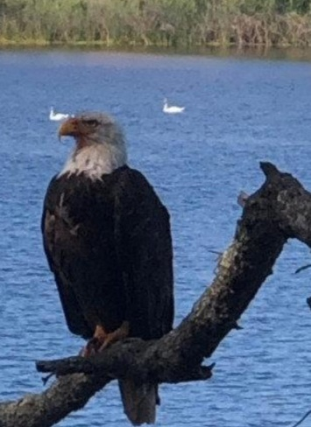
Conservation
Conservation is a necessary activity for the preservation of our landscapes and property values.
The IWMP recommends conservation as a form of water usage (or non-usage).
2018 Bills AB1668 and SB606 required long term standards for efficient use of water targeted a 20% reduction in usage by Dec 31,2020.
Recently the State presented a program, “Conservation as a Way of Life,” that encourages Californians to conserve now and expect that conserving water use to be part of our daily life.
What can Conservation do in Rancho Murieta?
Careful use of water can extend your use of potable water.
Careful use of water can keep our landscaping, especially trees, alive.
What Conservation in Rancho Murieta can’t do!
It can’t supply enough water to the existing community indefinitely to save our landscaping. Length and severity of droughts will be the determining factors.
It can’t supply enough water for new development landscaping.
The IWMP assumes a 30%-50% drought conservation rate
A Sacramento County peer review states that a 50% drought conservation rate is too aggressive. The number should be 15-20% for planning purposes.

Slide 16
CONSERVATION AND ITS IMPACT
Assuming a 30-50% Conservation rate:
A) A Sacramento County peer review states that a 50% drought conservation rate is too aggressive and places the community at risk of running out of water.
The number should be 15-20% (when planning for future development).
Conservation rates greater than 25% result in the loss of vegetation and creates a financial hardship on the community.
B) The Department of Public Health stated that a 50% conservation rate is too aggressive.
C) The study assumes conservation measures begin as soon as lake levels drop to 95% capacity. That means the community will be forced to cut back on water usage and sustain financial losses even during years of heavy rainfall.
D) The study states a 50% reduction in water use would save about 850 Af per year, but lacks a “trigger point” when the 50% drought conservation rate is assumed to kick in.
The study does not quantify the cost to the community for these draconian measures or address how the restrictions would be implemented and enforced.
E) Page 92 states, “… at this level of planning to 50% reduction is needed to meet the requirement of California Water Code, Section 10632.”
This statement is inaccurate.
The above mentioned Water Code refers to a plan all Districts must have in place to respond to an existing drought.
The regulation does not apply when planning for future development.
In other words, you would never plan to put a community in this position.

Slide 17
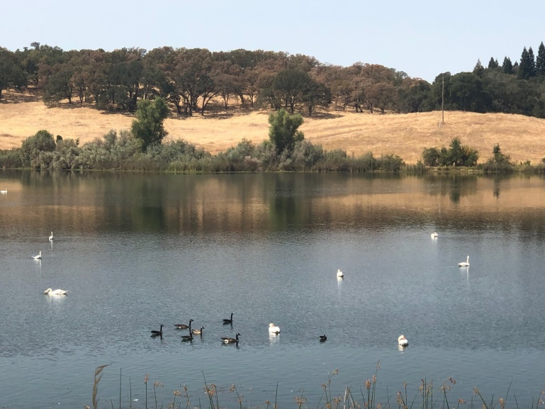
CLEMENTIA
Infrastructure needed to change to raw water.
In a drought?
Conversion Process
Type of Reservoir-Recreation
Quality of water- drainage/plant
Size- Needs a Bathymetric Study- What number to use now?

Slide 18
Clementia
The last three critical water reports assume Clementia to be a source of supply subject only to the cancellation of “swimming in the lake”.
Permit 16762 is the only one that allows us to pull water from the river. It does not permit us to fill up all three lakes. The permit says we can’t.
Our permitted storage is 3,900 acre feet. Clementia can be used but only at the expense of storing water in Calero.
We have assumed our permitted storage with stop logs is 4,750 acre feet.
Clementia is filled primarily by drainage from its 1,100 acre watershed. Water orders in 1979 order us to use as much drainage as possible.
Residential lots turn that drainage into urban stormwater. Urban stormwater cannot reach our drinking water and must be taken away
Replacing drainage with raw water from the Cosumnes will require action by the State Water Resources Control Board.
It is likely this will be protested. We cannot assume the outcome. It took years to resolve in 1979.
The formal SOLOS Response to the Clementia issue contains a 13 page analysis of the permitting, drainage, water quality and water treatment concerns.
What does using Clementia actually accomplish?
850af of raw water storage is added to the current RMCSD per annum annual storage. Requires permit amendments and adjustments to current practices and restrictions of body contact (swimming).

Slide 19
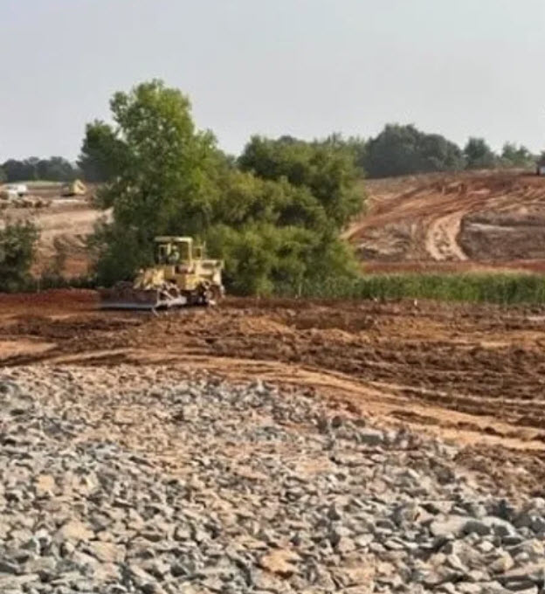
Water Supply
ADDITIONAL SUPPLY WITH LAKE CLEMENTIA AS A PERMITTED STORAGE RESERVOIR | ACRE FEET
Clementia Permitted Gross Storage | 850*
Clementia Evaporation using current 19.8% evaporation rates* | (168)
Seepage using current 7.7% seepage rates* | (65)
Net Permitted Clementia Raw Water Storage on June 1 (100% full) | 617
Calero & Chesbro Net Storage (from chart 1) | 2,613
Clementia Net Storage. (from above) | 617
Total Net Storage With 3 Permitted Reservoirs | 3,230
Total Present Annual Water Demand + All Annual Entitled Demand for which there are county approved final maps (chart #1 above) | 1,997.6
Excess Storage In Calero, Chesbro and Clementia on June 1. Pumping may not begin until November 1 | 1,256
Emergency Storage with 3 Reservoir Capacity | 1,873

Slide 20
CONCLUSIONS
Emergency water supply needs to be our top priority.
Preserve water for existing residents should be the next priority.
Preserving property value and quality of life is high priority also.
Easiest and least expensive way to preserve water is to eliminate the demand from future development.

Slide 21
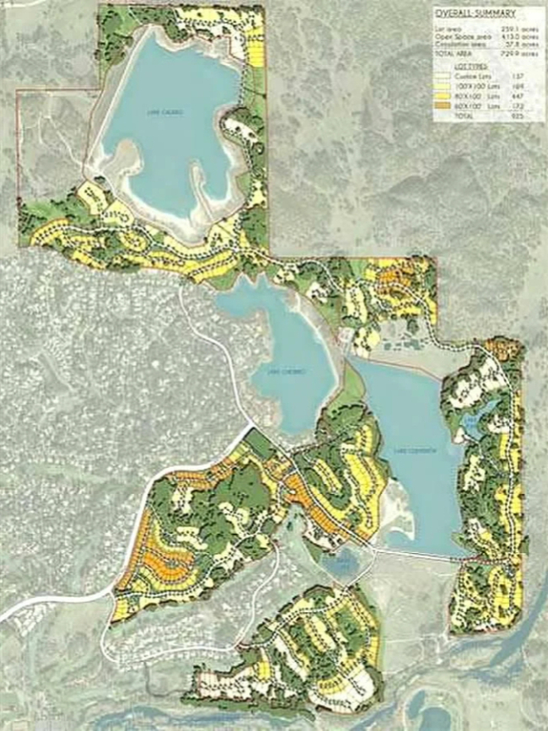
The End
Thank you for your support.
Questions & Comments:

